Slide 1


English Winery Tours
Presented to BABC by Penny Heyes

Slide 2
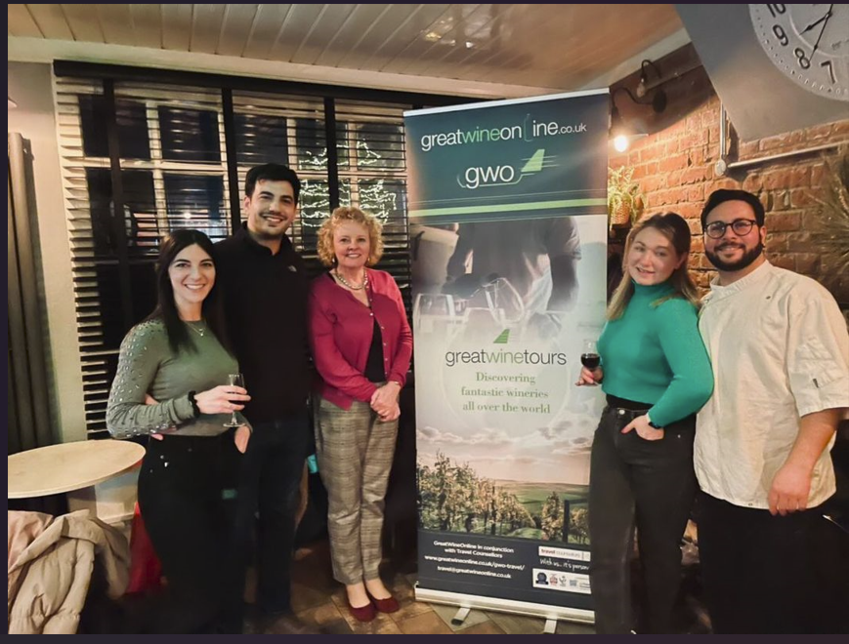
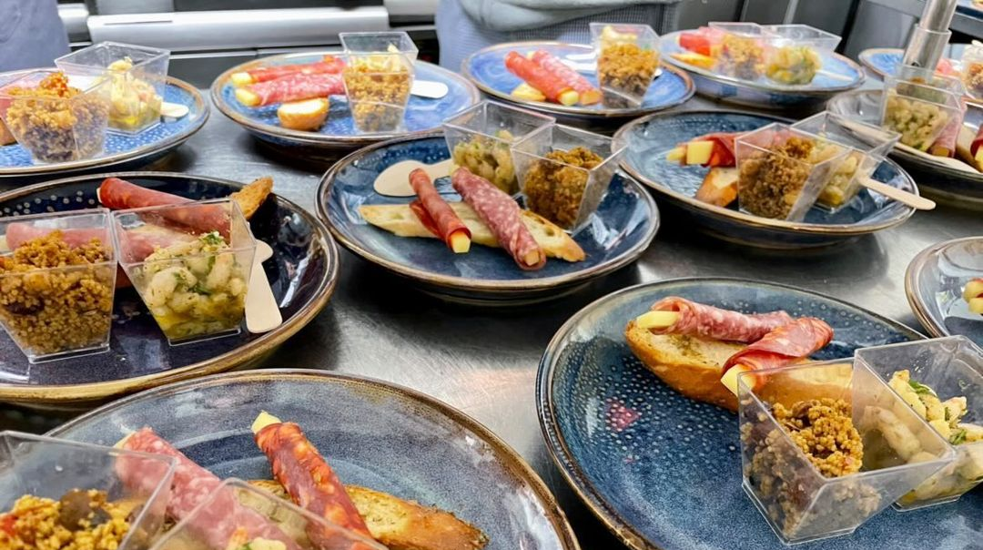
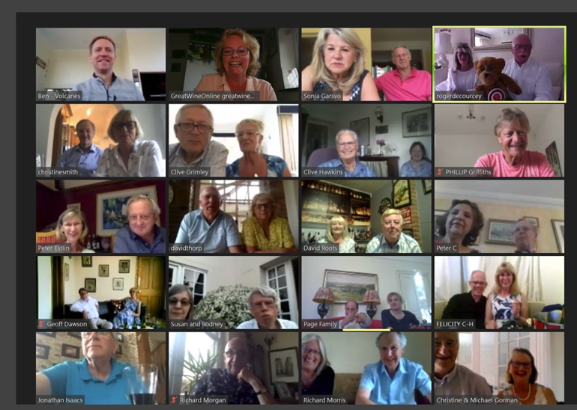



Background
Great Wine Online Limited (“GWO”) launched in 2015 by 2 experienced wine sector professionals as an eCommerce-based wine retailer offering a range of premium wines from high quality producers across the world.
Combined with entertaining and informative content, wine tasting events online and in person
GWO team loves nothing more than discovering fantastic wineries all over the globe and offering the wines to our customers in the UK.
Now delighted to be able to offer customers exclusive tours to visit these wineries too, through our partnership with a professional travel agent.
Our tours give customers the opportunity for an authentic wine region experience, not only visiting wineries but also taking in some local culture, history and iconic sights along the way.

Slide 3
Proposal for English Winery Tour
Option 1 for 3 nights
Visiting English Wineries and Vineyards in South East (near London)
Private, experienced guides
Wine tasting and meet the Winemakers / Owners
Lunches on site cooked by private chefs
Visit Cider Factory
Overnight stays in local luxury hotel with spa
Private transport

Slide 4
Option 1: 3 nights
Option 1
Day 1 | morning pick up at station for private transfer the visit 2 local family run artisanal wineries with lunch and guided tasting
Night 1 | dinner and overnight stay at local boutique winery
Day 2 | visit local winery and gin distillery
Night 2 | dinner at local gastro pub / overnight at local boutique hotel
Day 3 | local cultural tour to Castle and cider factory
Night 3 | dinner and overnight at local boutique hotel
Day 4 | depart

Slide 5
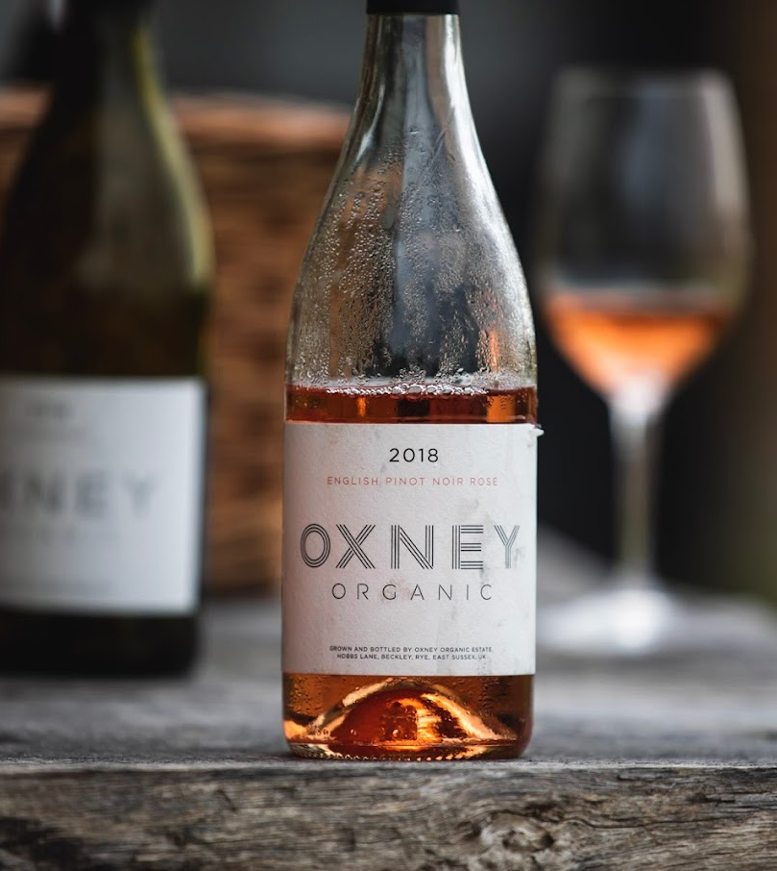
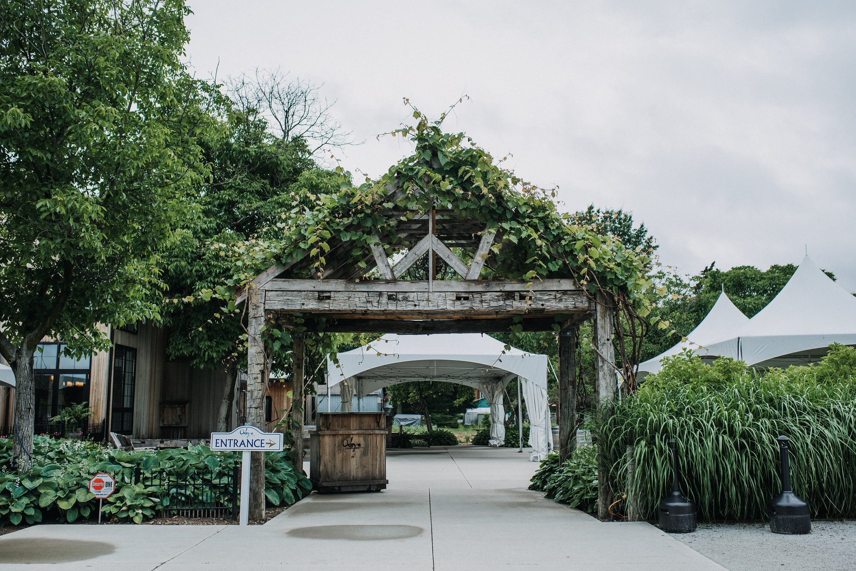
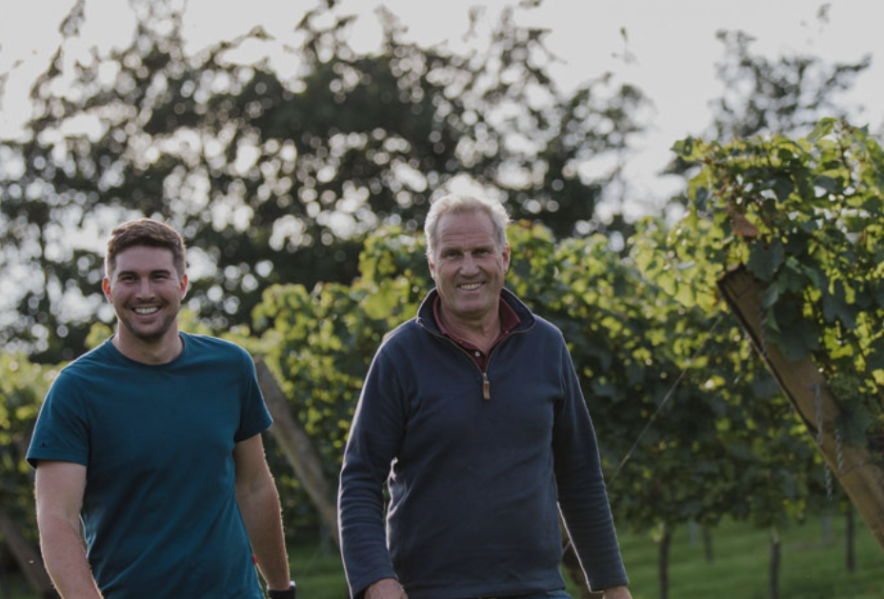
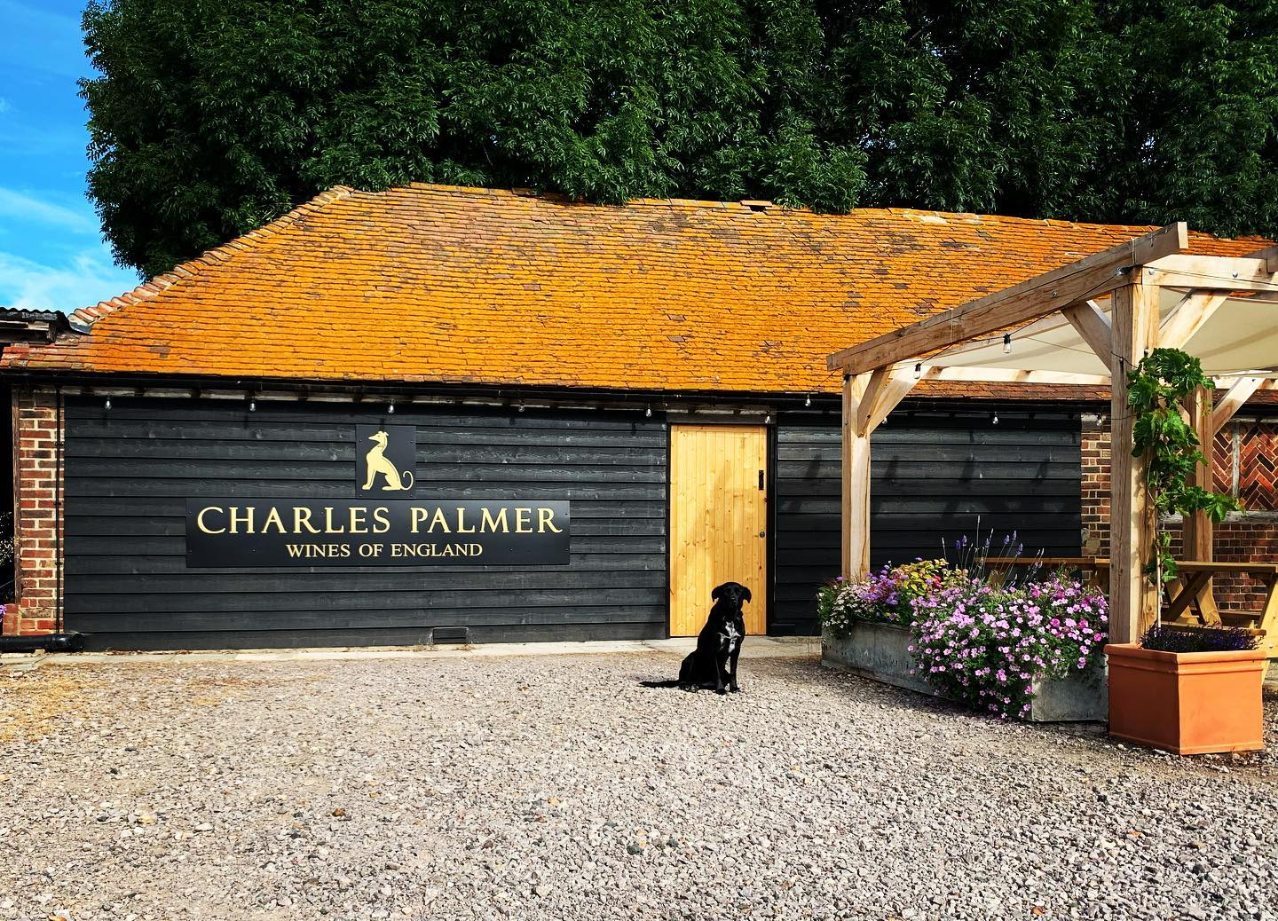
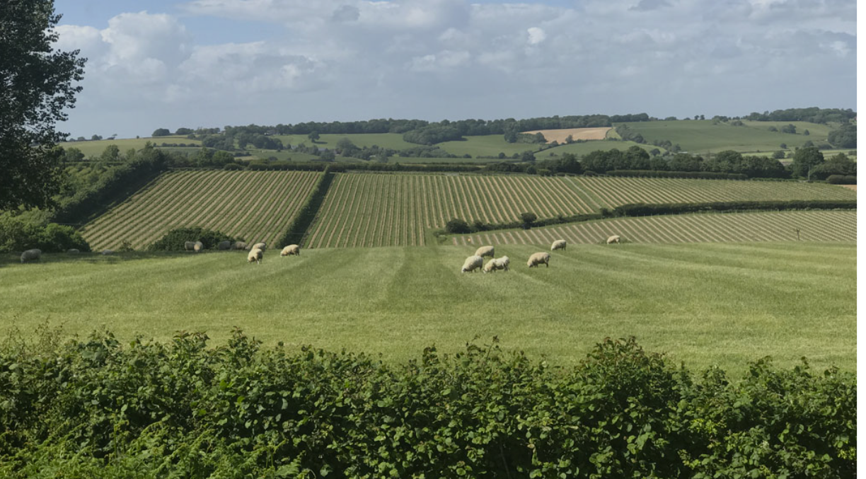
Day 1
Pick up from station following a scenic train ride from central London
full day guided tour of 2 artisanal vineyards
Extended tutored wine tastings
Expert wine & food guides
First Vineyard/ Winery: Charles Palmer, tour and Tasting
Vineyard feast lunch with wines paired
Second Vineyard/ Winery: Oxney, tour and tasting
Collection and transport to and from hotel
HD video and photography from your day
Overnight stay at local boutique spa hotel
Dinner

Slide 6
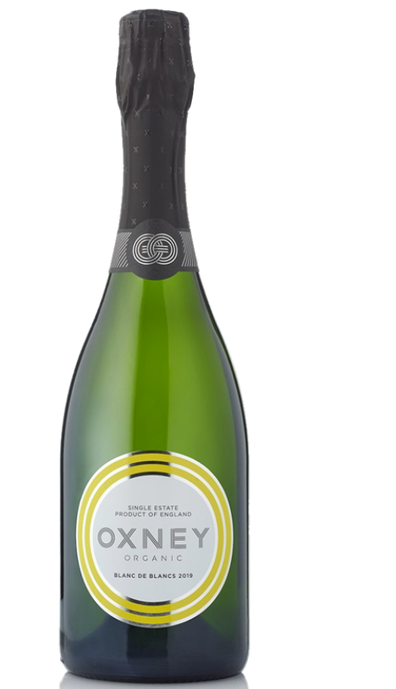
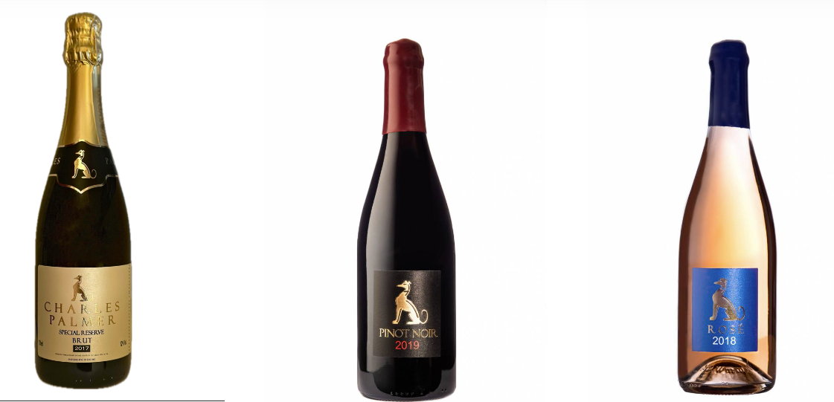
Day 1 Wineries and Vineyards
Charles Palmer
Oxney Estate
Charles Palmer and his wife Sally first took on Wickham Manor Estate in 1998 after having farmed previously in West Sussex for 21 years.
Charles and his family hand planted their first vines in 2006 specifically with the aim of producing a sparkling wine of the highest standard.
The estate covers a total of 120 acres of which 40 acres are in vines.
Production of every wine is carried out in house by winemakers Charles and his son Robert, in small batches with meticulous attention to detail.
Since 2018 as a result of the constantly warming climate, the family now makes a range of still wines along side their sparkling wines, using specific clones of Pinot Noir and Chardonnay that Charles planted with this in mind.
Every effort is made to ensure only the best grapes are produced and selected according to the family’s exacting standards. The result is a small and exciting collection of vintage still and sparkling wines, each vintage is unique and characterful in its own way.
Oxney is the living and hard-working dream of a couple,
Kristin Syltevik and her partner Paul Dobson who gave up their
former careers to become farmers and wine makers
Over 35 acres of vines their organic grapes make an increasingly celebrated range of still and sparkling wines.
Oxney’s vineyard work focuses on promoting natural disease resistance: cover crops, natural sprays, careful canopy management and manual and mechanical weed control all result in stronger vines and healthier grapes
The wines are made in a converted Grade II listed square oast house, kitted out in the latest winery equipment.
Their winemaking relies on technology such as temperature control and gentle pneumatic pressing, with a sustainable, low-intervention approach, favouring wild ferments, no filtration and minimal use of SO2.
Biomass heat for the winery operations is generated using wood chip sourced from their own coppiced woodland.

Slide 7
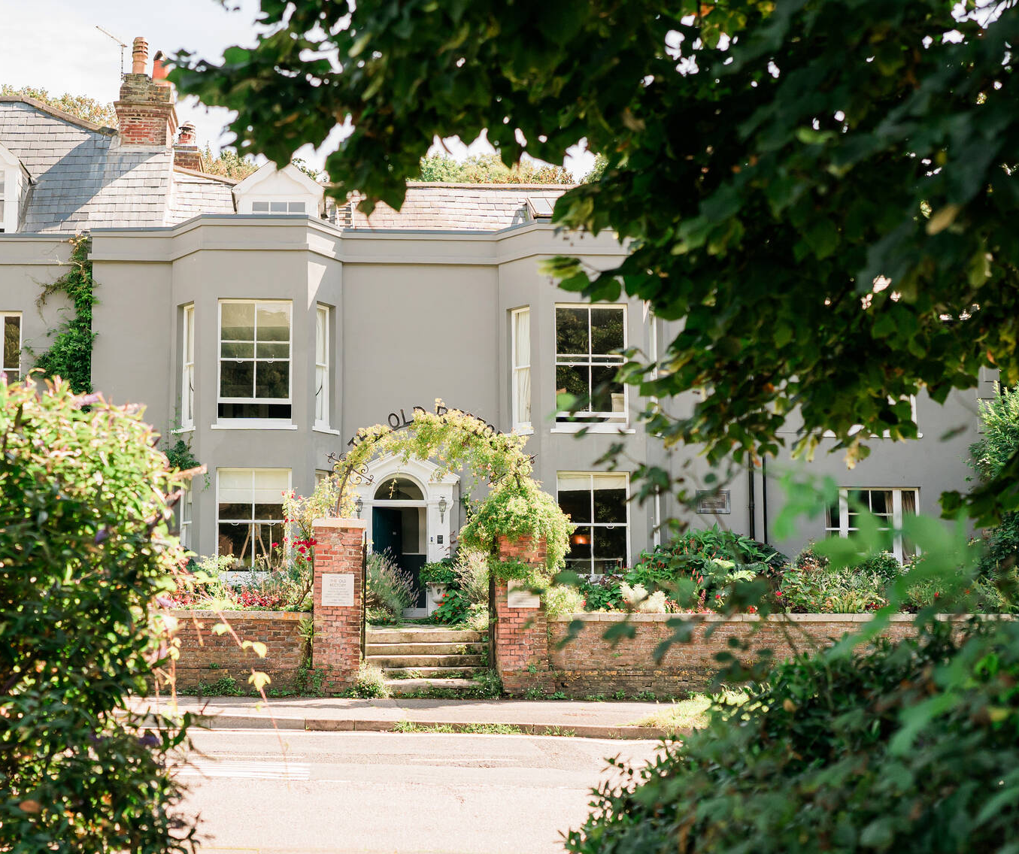
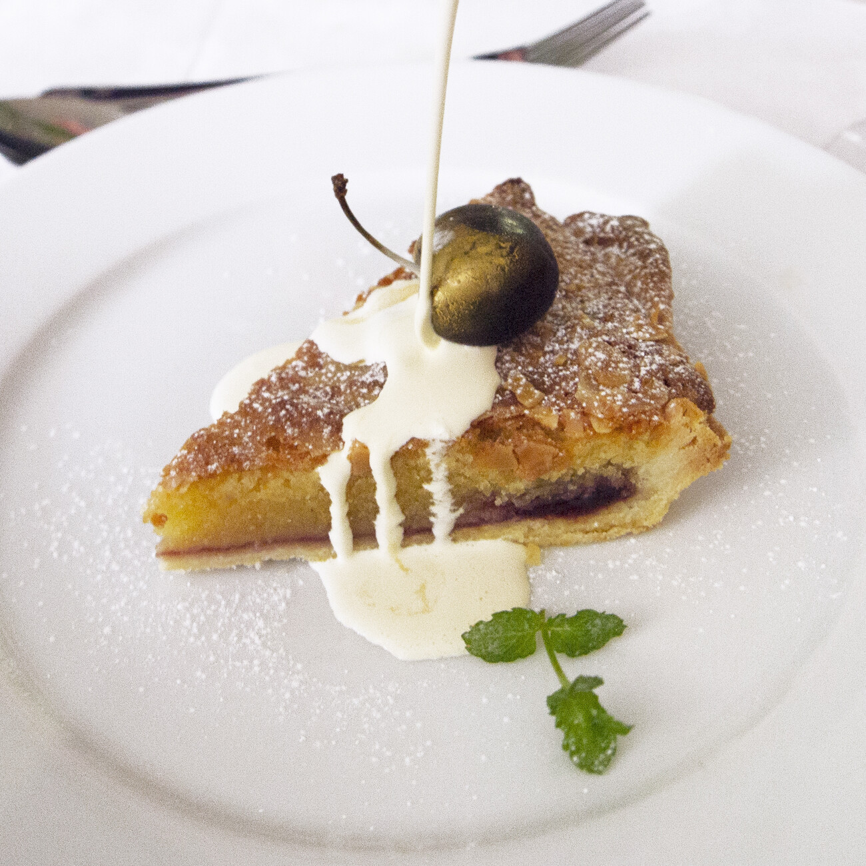
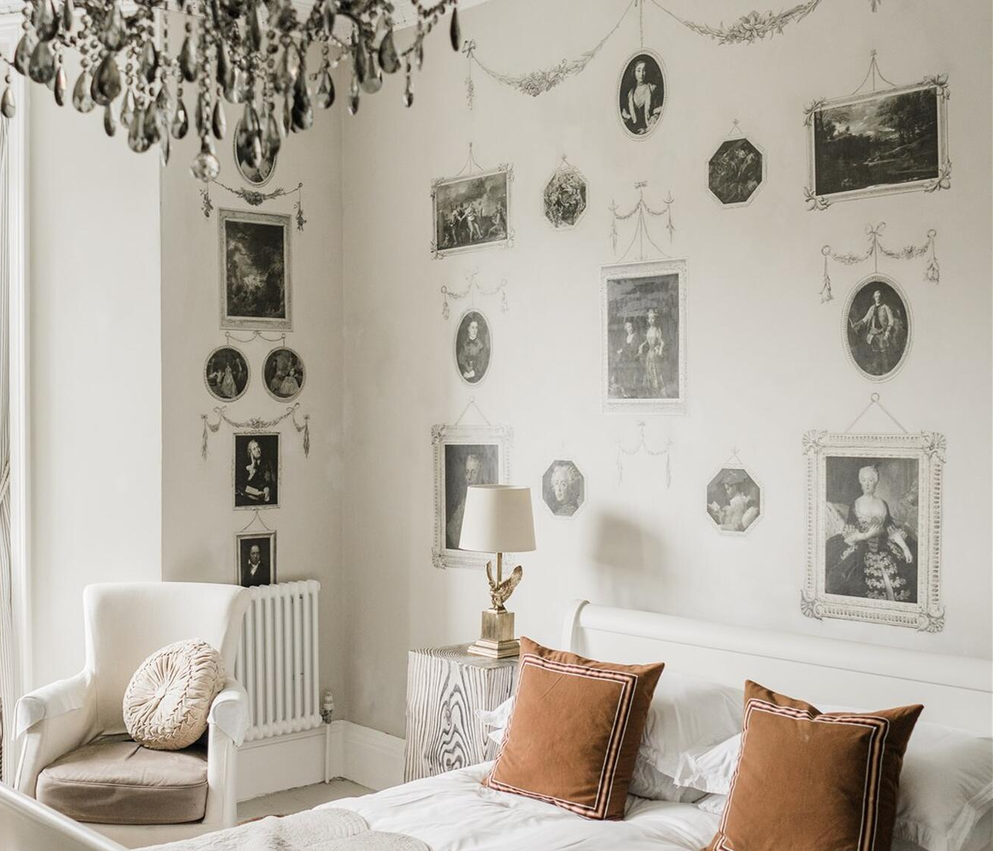
Day 1
Night 1
Arrive at hotel (Old Rectory Hastings)
Welcome Dinner
Tasting menu with local ingredients and accompanying wines
Spa treatments available at hotel if arrive early
Overnight stay at hotel (night 1)

Slide 8
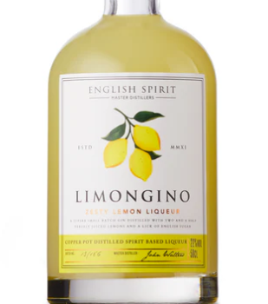
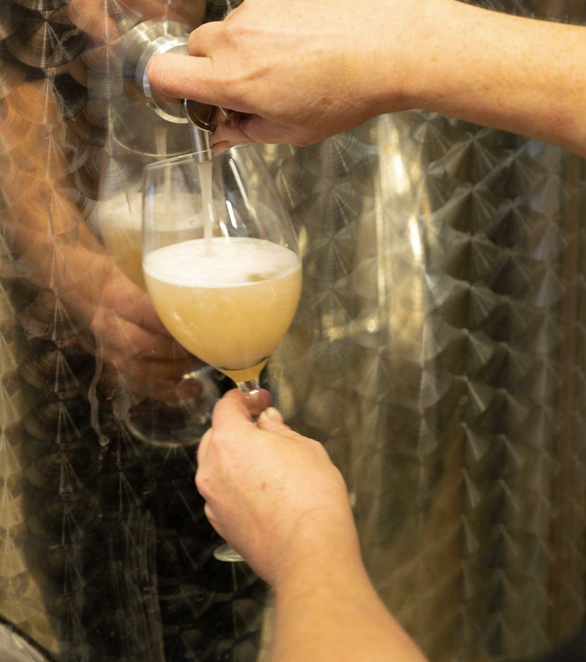
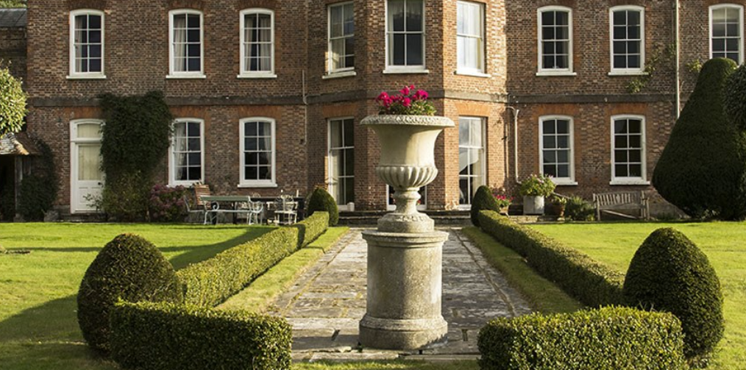
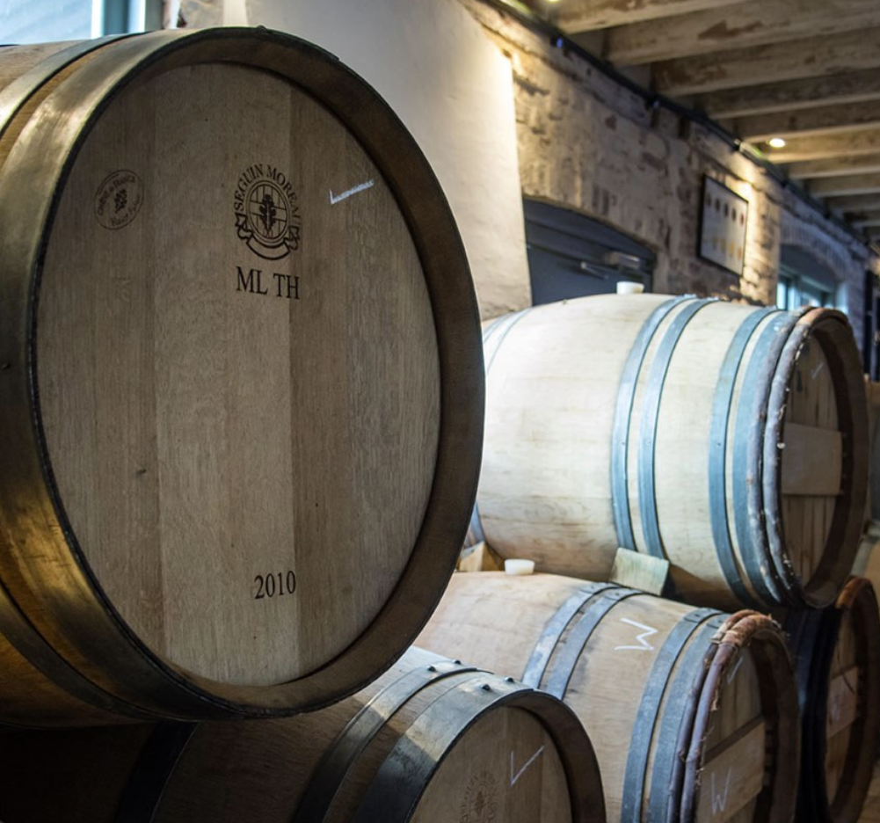
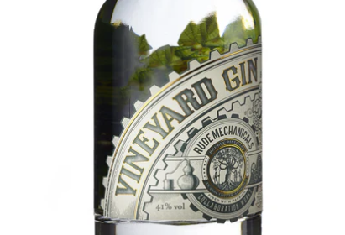
Day 2
Pick up from hotel for full day guided tour of 2 artisanal vineyards
One of these has diversified into Gin, Rum and other spirit Distillation
Extended tutored wine (and spirit) tastings
Expert wine & food guides
First Vineyard/ Winery / Gin Distillery: Henners, tour and Tasting
Vineyard feast lunch with wines paired
Second Vineyard/ Winery: Mountfield, tour and tasting
Collection and transport to and from hotel
HD video and photography from your day
Overnight stay at hotel (night 4)
Dinner

Slide 9
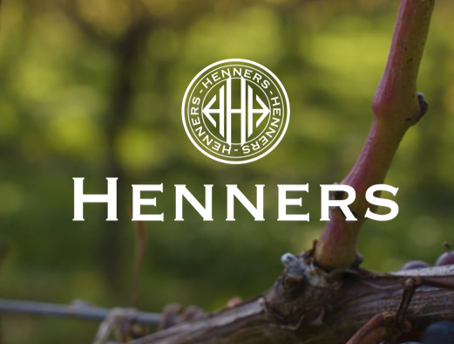
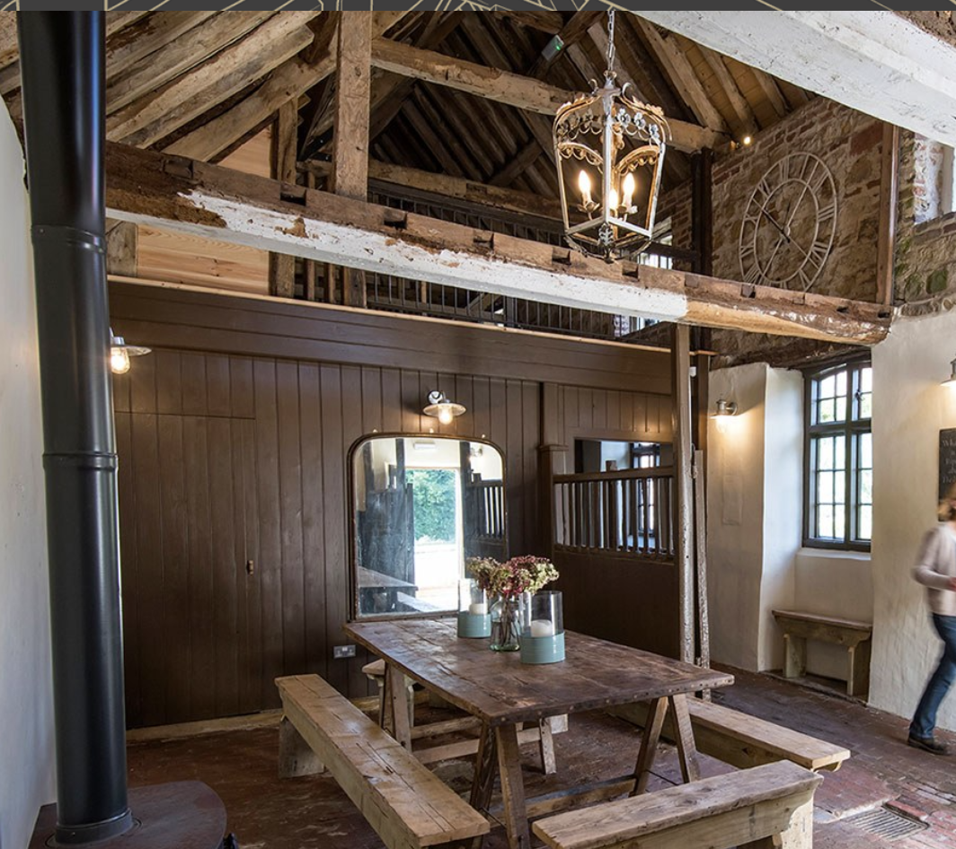
Day 2 Wineries and Vineyards
Henners
Mountfield
Nestled 5 miles from the sea, Henners Vineyard was established in the picturesque village of Herstmonceux in 2007.
Planted with three classic sparkling grape varieties, Chardonnay, Pinot Noir and Pinot Meunier, the vineyard is in one of the driest, sunniest pockets of England.
Strong coastal influence, low elevation and rich, free-draining clay soils make the site ideally suited for the production of quality sparkling and still wines.
Sea breezes are key, minimising frost risk, reducing disease pressure and bringing a crisp salinity to the wines.
In the winery, a non interventionist approach is taken, made possible by the quality of the fruit.
Multiple vine clones and varieties are planted to give a broad palate of wines for final blending and oak barrels contribute character, depth, richness and layers to the wines.
Henners gin is distilled entirely from scratch using wine from their own vineyards, in copper pot alembic stills at English Spirit Distillery nearby. Other spirits are also now made by Henners including a Rum and a lemon liquor
The Mountfield Winery in Sussex has been developed over the last 12 years.
The 2016 Classic Cuvee, 2017 Rose and 2015 Blanc de blancs were released last year.
The vines were planted in 2012 with the vineyard facing south, at 50-85 meters altitude.
It has good protection from wind and frost, and has great mineral balance.
The soil is a mixture of greensand and clay over a bedrock of sandstone
The owners developed an old dairy unit to create the winery next to the vineyard, so there is no delay from vine to press, preserving the quality of the fruit.
The tasting room is in the stables next to the house,
It has an amazing timber interior and a modern kitchen

Slide 10
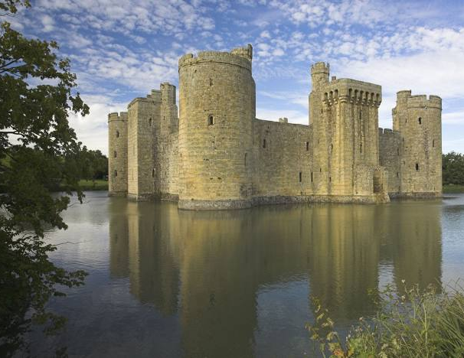
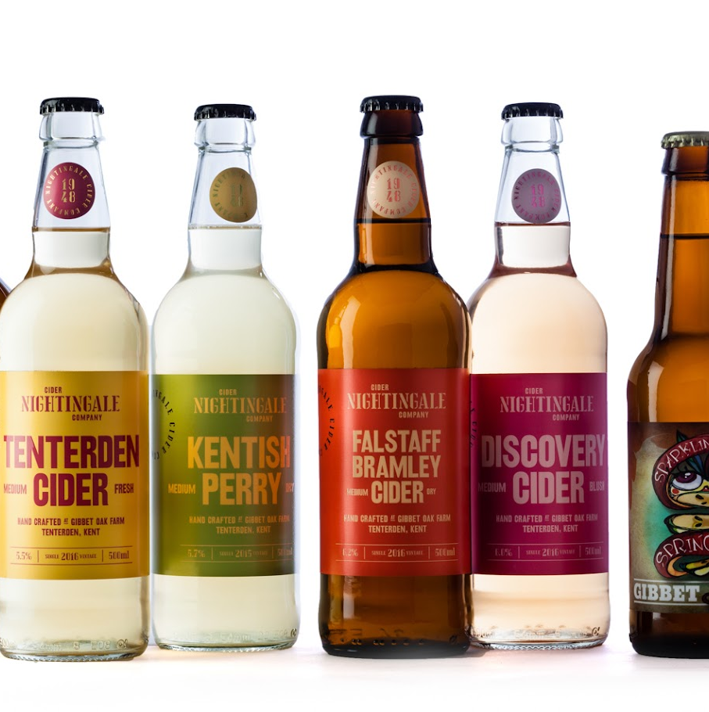
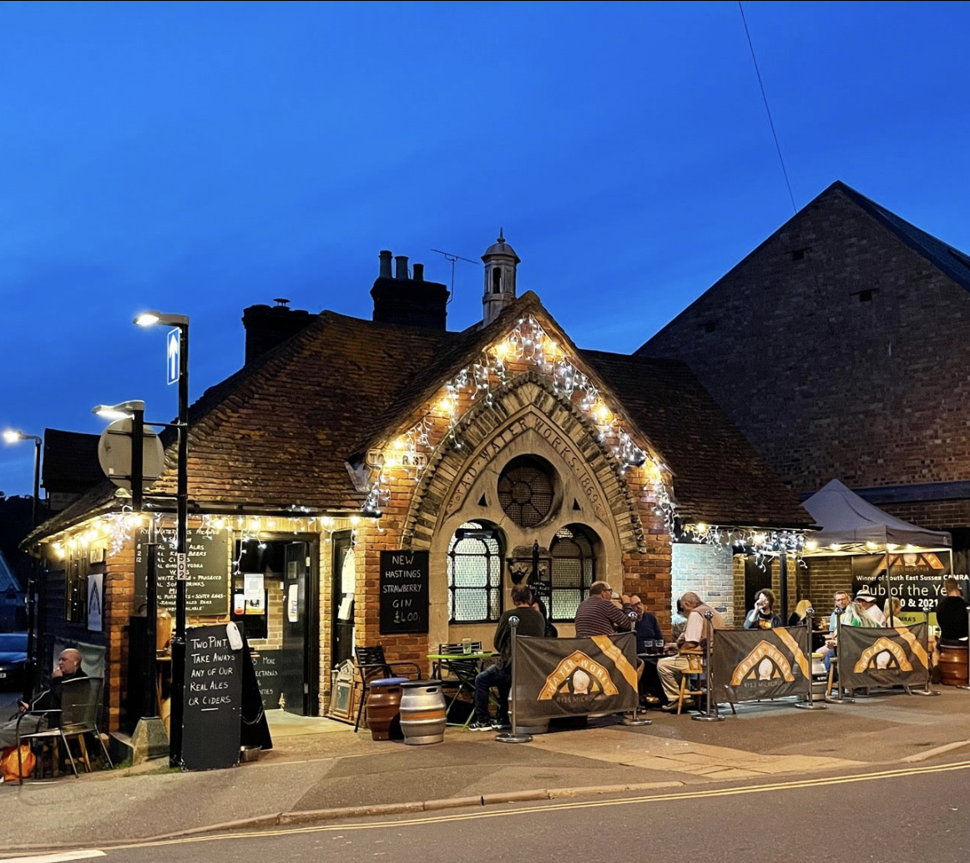
Day 3
Pick up from hotel
Visit to local landmark (Bodiam Castle)
Pub lunch
Visit cider factory at Nightingales
Stop at Waterworks taproom (local brewery) for local beer sampling
Return to hotel / overnight stay (night 5)
Dinner

Slide 11
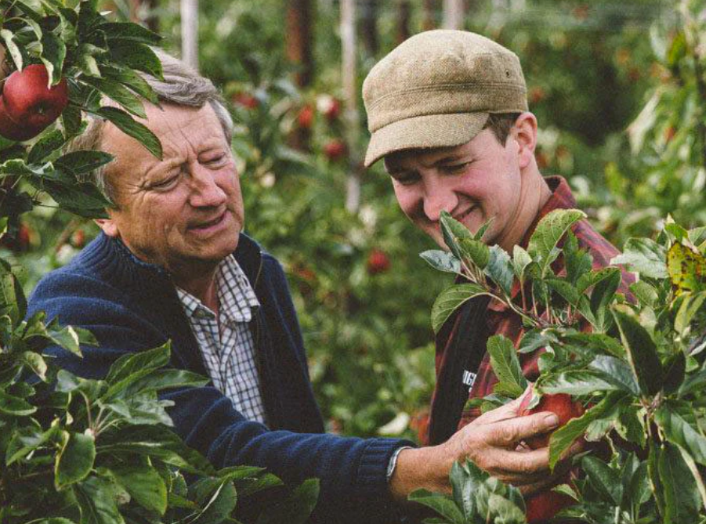
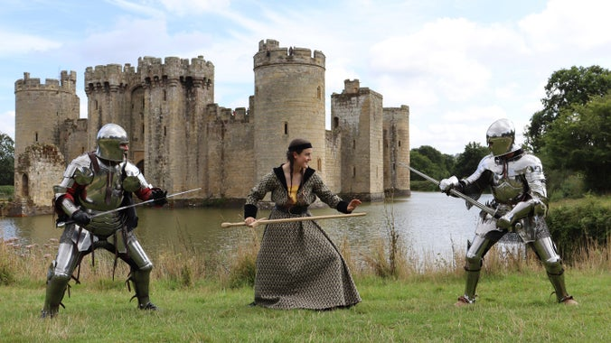
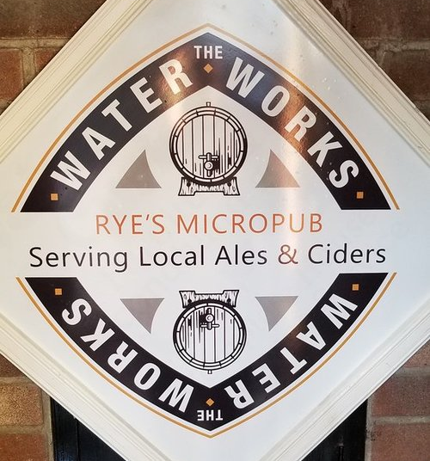
Day 3 Visits
Nightingales Cider Factory
The Nightingale family farm and orchards are located in Tenterden, Kent, the Garden of England
Fruit farmers since 1948. Kent is called The Garden of England.
The founder, Sam Nightingale, began making cider as a hobby under the name Gibbet Oak Cider and selling to local events.
His first bottled ciders were released in 2013 In 2015, Sam swapped his job in sound recording for muddy boots and overalls, and returned to the family farm to concentrate on doing what he loved.
Bodiam Castle
Bodiam Castle was built around 1385 by Sir Edward Dallingridge and his wife Elizabeth. They lived in a turbulent age, with protests and social upheaval caused by the Black Death and royal disputes that led to the Wars of the Roses.
A 14th-century moated castle near Robertsbridge in East Sussex, England, it was built with the permission of Richard II, ostensibly to defend the area against French invasion during the Hundred Years' War
This moated castle with a ruined interior features spiral staircases, battlements and a portcullis.
A stone-by-stone survey undertaken in 2016 found over 800 inscriptions. Banker’s marks were the most common marks found and would have been made by those roughing out the stone for use in the external walls.
Marks made by fine masons are far less common and are only found in the high status areas of the castle. These would have been made by expert masons responsible for detailed carving and quality control.
The Rye Waterworks
The first Micropub to open in South East Sussex.
It is situated in a building steeped with history originally a water pump house for 300 years then a soup kitchen dating from the 1890s
Now a family business serving eight local ales, two keg beers and twelve local ciders along with a selection of wines, gins & soft drinks.

Slide 12

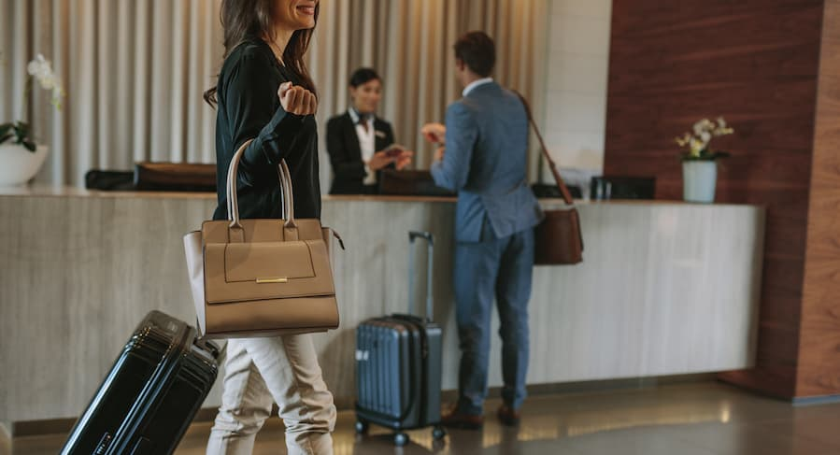
Day 4
After breakfast, guests depart
Gift bag will be given to every guest to include wine related gifts and local food stuffs and a bottle of wine from one of the wineries
The Tour ends here
Thank you!

Slide 13
Option 2: 5 nights
Option 2
Day 1 | pick up at station for private transfer for gala dinner and tasting menu
Night 1 | overnight stay at local boutique spa hotel and dinner
Day 2 | Visit internationally successful winery with Masterclass and lunch
Night 2 | dinner and overnight stay at local boutique winery
Day 3 | visit 2 local artisanal family run wineries with lunch and guided tasting
Night 3 | dinner at local gastro pub / overnight at local boutique hotel
Day 4 | visit local artisanal winery and gin distillery for tasting and lunch / afternoon visit to another local winery for guided tasting
Night 4 | dinner at local gastro pub / overnight at local boutique hotel
Day 5 | local cultural tour to Castle and cider factory
Night 5 | dinner and overnight at local boutique hotel
Day 6 | depart

Slide 14
Day 1
Day 1
Pick up from Station following a scenic train ride from central London
Arrive at hotel (Old Rectory Hastings)
Welcome Dinner
Tasting menu with local ingredients and accompanying wines
Spa treatments available at hotel if arrive early
Overnight stay at hotel (night 1)

Slide 15
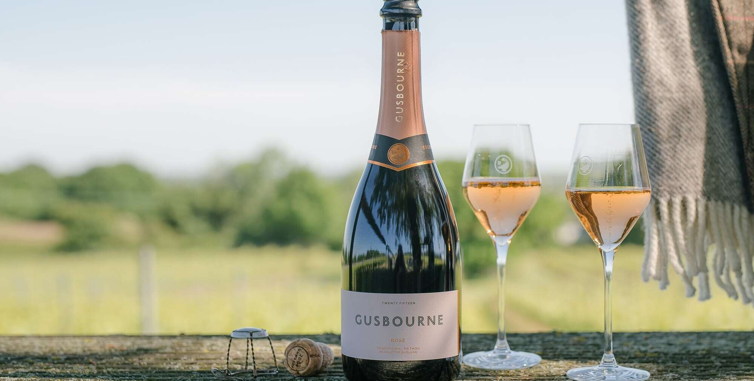
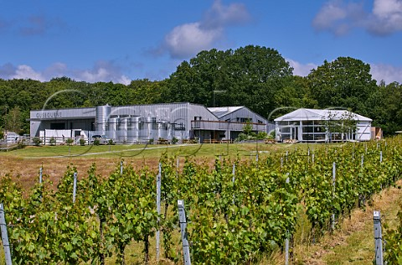
Day 2
Pick up from hotel after breakfast
Visit to Gusbourne Winery
Tour and lunch / masterclass with Gusbourne Ambassador
Return to hotel / Overnight stay
Dinner at Hotel
Gusbourne, one of the larger English Wineries, is the only three-time winner of the IWSC (International Wine & Spirit Challenge) English Wine Producer of the Year.
Founded by Andrew Weeber, the first vines were planted in 2004,
Chardonnay, Pinot Noir and Pinot Meunier grapes are grown across the Gusbourne Estate, with 60 hectares in Appledore, Kent and 30 hectares next to the Goodwood Estate in West Sussex.
Their debut vintages – Brut Reserve 2006 and Blanc de Blancs 2006 – were released in 2010 to critical acclaim, earning accolades from the world’s most exacting wine critics.
Gusbourne sparkling and still wines continue to win prestigious national and international industry awards every year.

Slide 16
Day 3
Pick up from hotel after breakfast
full day guided tour of 2 artisanal vineyards
Extended tutored wine tastings
Expert wine & food guides
First Vineyard/ Winery: Charles Palmer, tour and Tasting
Vineyard feast lunch with wines paired
Second Vineyard/ Winery: Oxney, tour and tasting
Collection and transport to and from hotel
HD video and photography from your day
Overnight stay at local boutique spa hotel
Dinner

Slide 17
Day 3 Wineries and Vineyards
Charles Palmer
Oxney Estate
Charles Palmer and his wife Sally first took on Wickham Manor Estate in 1998 after having farmed previously in West Sussex for 21 years.
Charles and his family hand planted their first vines in 2006 specifically with the aim of producing a sparkling wine of the highest standard.
The estate covers a total of 120 acres of which 40 acres are in vines.
Production of every wine is carried out in house by winemakers Charles and his son Robert, in small batches with meticulous attention to detail.
Since 2018 as a result of the constantly warming climate, the family now makes a range of still wines along side their sparkling wines, using specific clones of Pinot Noir and Chardonnay that Charles planted with this in mind.
Every effort is made to ensure only the best grapes are produced and selected according to the family’s exacting standards. The result is a small and exciting collection of vintage still and sparkling wines, each vintage is unique and characterful in its own way.
Oxney is the living and hard-working dream of a couple,
Kristin Syltevik and her partner Paul Dobson who gave up their
former careers to become farmers and wine makers
Over 35 acres of vines their organic grapes make an increasingly celebrated range of still and sparkling wines.
Oxney’s vineyard work focuses on promoting natural disease resistance: cover crops, natural sprays, careful canopy management and manual and mechanical weed control all result in stronger vines and healthier grapes
The wines are made in a converted Grade II listed square oast house, kitted out in the latest winery equipment.
Their winemaking relies on technology such as temperature control and gentle pneumatic pressing, with a sustainable, low-intervention approach, favouring wild ferments, no filtration and minimal use of SO2.
Biomass heat for the winery operations is generated using wood chip sourced from their own coppiced woodland.

Slide 18
Day 4
Pick up from hotel for full day guided tour of 2 artisanal vineyards
One of these has diversified into Gin, Rum and other spirit Distillation
Extended tutored wine (and spirit) tastings
Expert wine & food guides
First Vineyard/ Winery / Gin Distillery: Henners, tour and Tasting
Vineyard feast lunch with wines paired
Second Vineyard/ Winery: Mountfield, tour and tasting
Collection and transport to and from hotel
HD video and photography from your day
Overnight stay at hotel (night 4)
Dinner

Slide 19
Day 4 Wineries and Vineyards
Henners
Mountfield
Nestled 5 miles from the sea, Henners Vineyard was established in the picturesque village of Herstmonceux in 2007.
Planted with three classic sparkling grape varieties, Chardonnay, Pinot Noir and Pinot Meunier, the vineyard is in one of the driest, sunniest pockets of England.
Strong coastal influence, low elevation and rich, free-draining clay soils make the site ideally suited for the production of quality sparkling and still wines.
Sea breezes are key, minimising frost risk, reducing disease pressure and bringing a crisp salinity to the wines.
In the winery, a non interventionist approach is taken, made possible by the quality of the fruit.
Multiple vine clones and varieties are planted to give a broad palate of wines for final blending and oak barrels contribute character, depth, richness and layers to the wines.
Henners gin is distilled entirely from scratch using wine from their own vineyards, in copper pot alembic stills at English Spirit Distillery nearby. Other spirits are also now made by Henners including a Rum and a lemon liquor
The Mountfield Winery in Sussex has been developed over the last 12 years.
The 2016 Classic Cuvee, 2017 Rose and 2015 Blanc de blancs were released last year.
The vines were planted in 2012 with the vineyard facing south, at 50-85 meters altitude.
It has good protection from wind and frost, and has great mineral balance.
The soil is a mixture of greensand and clay over a bedrock of sandstone
The owners developed an old dairy unit to create the winery next to the vineyard, so there is no delay from vine to press, preserving the quality of the fruit.
The tasting room is in the stables next to the house,
It has an amazing timber interior and a modern kitchen

Slide 20
Day 5
Pick up from hotel
Visit to local landmark (Bodiam Castle)
Pub lunch
Visit cider factory at Nightingales
Stop at Waterworks taproom (local brewery) for local beer sampling
Return to hotel / overnight stay (night 5)
Dinner

Slide 21
Day 5 Visits
Nightingales Cider Factory
The Nightingale family farm and orchards are located in Tenterden, Kent, the Garden of England
Fruit farmers since 1948. Kent is called The Garden of England.
The founder, Sam Nightingale, began making cider as a hobby under the name Gibbet Oak Cider and selling to local events.
His first bottled ciders were released in 2013 In 2015, Sam swapped his job in sound recording for muddy boots and overalls, and returned to the family farm to concentrate on doing what he loved.
Bodiam Castle
Bodiam Castle was built around 1385 by Sir Edward Dallingridge and his wife Elizabeth. They lived in a turbulent age, with protests and social upheaval caused by the Black Death and royal disputes that led to the Wars of the Roses.
A 14th-century moated castle near Robertsbridge in East Sussex, England, it was built with the permission of Richard II, ostensibly to defend the area against French invasion during the Hundred Years' War
This moated castle with a ruined interior features spiral staircases, battlements and a portcullis.
A stone-by-stone survey undertaken in 2016 found over 800 inscriptions. Banker’s marks were the most common marks found and would have been made by those roughing out the stone for use in the external walls.
Marks made by fine masons are far less common and are only found in the high status areas of the castle. These would have been made by expert masons responsible for detailed carving and quality control.
The Rye Waterworks
The first Micropub to open in South East Sussex.
It is situated in a building steeped with history originally a water pump house for 300 years then a soup kitchen dating from the 1890s
Now a family business serving eight local ales, two keg beers and twelve local ciders along with a selection of wines, gins & soft drinks.

Slide 22
Day 6
After breakfast, guests depart
Gift bag will be given to every guest to include wine related gifts and local food stuffs and a bottle of wine from one of the wineries
The Tour ends here
Thank you!

Slide 23
Prices
Option 2: 5 nights
Option 1: 3 nights
3 nights at the hotel (breakfast included)
Lunch and Dinner every day
Transport to and from hotel for all visits
Gift bag
Tours and Tastings
Prices between: £2062 – 2248 / US $2676 - 2920
5 nights at the hotel (breakfast included)
Lunch and Dinner every day
Transport to and from hotel for all visits
Gift bag
Tours and Tastings
Prices between: £ 2879- 3224/ US$ 3739 - 4188
Prices quoted are per person
Prices depend on time of year (based on a late May / early June 2025 dates)
Prices also depend on size of party –minimum size 10 people
Exchange rate at time of proposal £0.78 to US$ 1
Does not include any spa treatments at hotel –at guest’s own cost

Slide 24
Terms and Conditions
See attached Word document

